Slide 1

Data Analytics for Environmental Data
CSCI 5559 – database systems
05-06-2015
Team Members:
Vasudha
Rania
Somaia
Ramesh

Slide 2
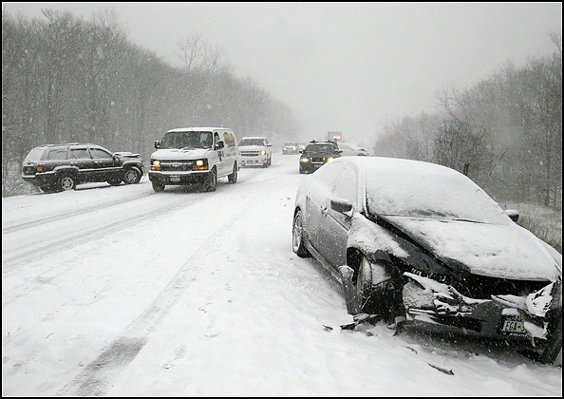

Introduction
Weather conditions are considered to be a factor that affects the number of road accidents.
Moreover, as the weather also affects mobility. That’s the reason for more mobility during bad weathers.

Slide 3
The goal of the project
Collect information about the number of accidents that have happened over the past years starting (2001 to 2015).
Study the relationship between these numbers of accidents with the weather conditions to get the prediction.
Avoid the increasing of accident by predicting the future result via Linear Regression Analysis

Slide 4
Difficulties
We faced how to determine the best process to predict the relation between weather condition and no.of.accidents. However, we found that Linear Regression Analysis is the best method to predictions.

Slide 5
Linear Regression Analysis
Regression analysis is a statistical process.
Many aspects of regression analysis including: choosing the type of regression analysis, interpreting the results, determining how well the model fits, making predictions, and checking the assumptions.

Slide 6
Linear Regression Analysis
Regression analysis is used when you want to predict a continuous dependent variable from a number of independent variables.
Regression analysis is also used to understand which among the independent variables are related to the dependent variable, and to explore the forms of these relationships.

Slide 7
Regression models
Regression models involve the following variables:
The unknown parameters, denoted as β, which may represent a scalar or a vector.
The independent variables, X.
The dependent variable, Y.
In various fields of application, different terminologies are used in the place of dependent and independent variables .
A regression model relates to y to a function of x and β
b₁ = Σ [ (x_{i} - x)(y_{i} - y) ] / Σ [ (x_{i} - x)²] b₀ = y - b₁ * x

Slide 8
Software Libraries
My SQL 5.5
NetBeans IDE 7.2.1
3 Minitab 17

Slide 9
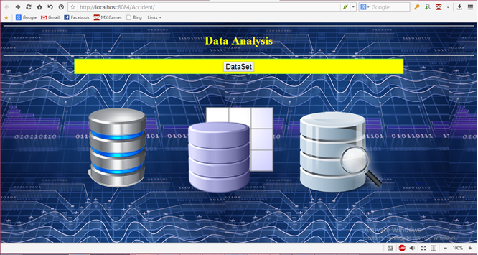
Result

Slide 10
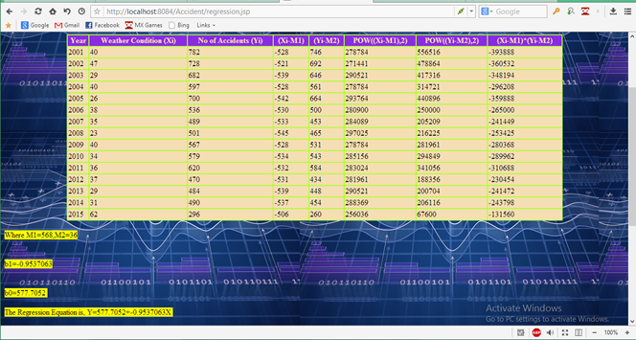
Result

Slide 11
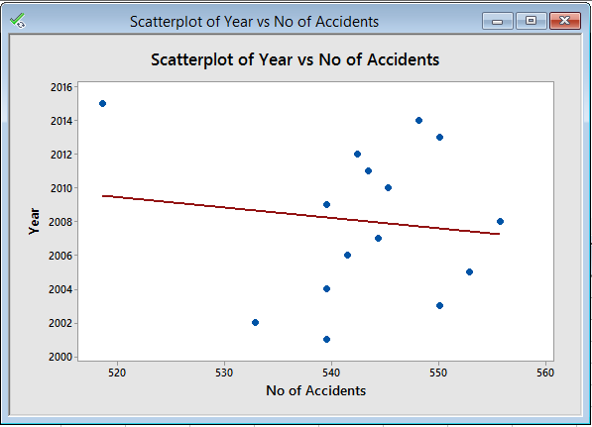
Result

Slide 12
Conclusion
This analysis is used to predict number of accidents in the future for different weather conditions.

Slide 13


